Slide 1
The connie stephens’ diamond pavilion is located next to THE Mike Stephens’ winners circle featuring views from turn 10 to finish line
New for 2020 racing season!

Slide 2
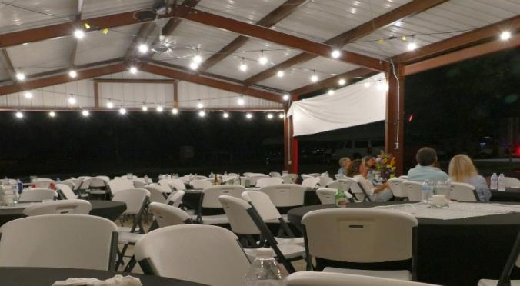
Grand opening was August 3, 2019.
Pavilion is 30’ x 60’ and seats over 125 guests at 14 tables with space to move around. The lights are amazing, but not as amazing as the “Big Ass” fans.

Slide 3
pavilion rental: $200 for a luncheon or dinner ($600 for two full days)
Accoutrements:
All brand new 72” round tables @ $12 ea
8’ tables @ $8 ea
comfortable folding chairs @ $3 ea
table covers @ $2 ea (black or white spandex)

Slide 4
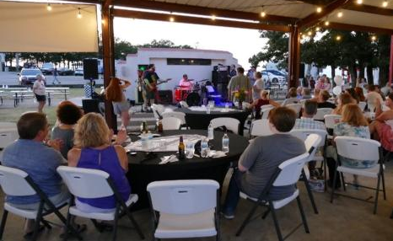
The caterer set up on the winners’ circle west side so that a band could entertain guests on the east side while enjoying their meals.

Slide 5
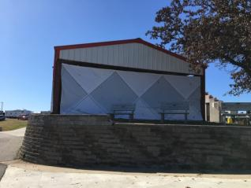
Side walls for cooler weather!
Call now to book! (918) 356-4814
Note: side walls are not rated for high wind conditions.

